Slide 1

Principles of Economics
Swagat Kishore Mishra
Lecturer, Dept. of Economics
Email: swagat@bits-goa.ac.in / sayswagat@gmail.com
VOIP: 207 PSRN: 485 CHAMBER: A-301/16
Tel. 0832-2580207 (O) 08879506995 (M)

Slide 2

MACROECONOMICS
WELL! WHEN AGGREGATES MATTER………

Slide 3


Slide 4
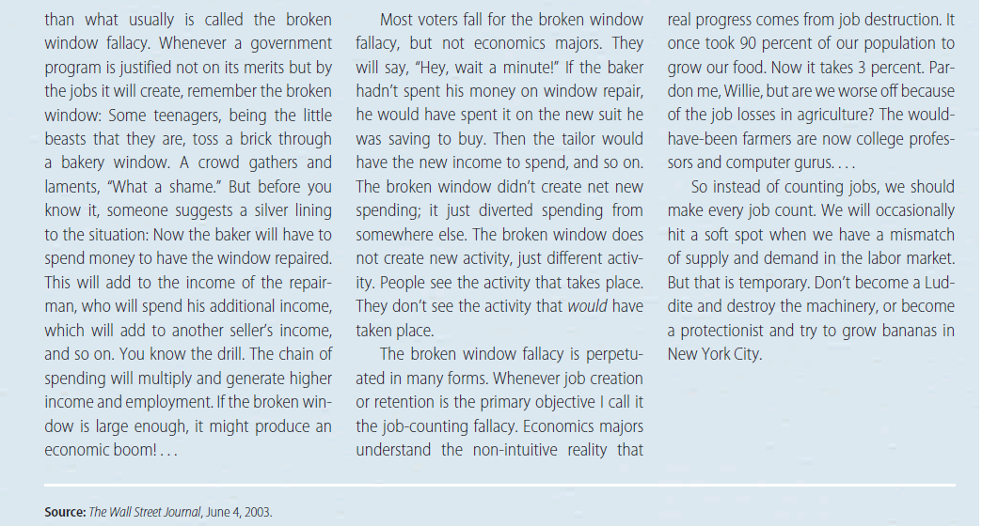

Slide 5

Contents
Basic Concepts of National Accounts Aggregates
Economic performance indicators
Three methods of NI estimation
Production approach
Income approach
Expenditure approach
12/7/2012
5

Slide 6
Basic definitions are given by System of National Accounts (SNA) of the United Nations, World Bank, International Monetary Fund (IMF), Organisation for the Economic Co operation and Development (OECD) and the European Union (EU).
NATIONAL PRODUCT & NATIONAL INCOME
CATEGORIES OF EXPENDITURE
SAVING
PRIVATE INCOME, PERSONAL INCOME & PERSONAL DISPOSABLE INCOME
GROSS Vs NET VALUE ADDED
FACTOR COST & MARKET PRICES
Indirect taxes & Subsidies
CURRENT Vs CONSTANT PRICES

Slide 7
The national product measures all goods and services arising out of economic activity while national income is the sum of all incomes as a result of the economic activity.
Income of a country can also be viewed in terms of the money value of income flowing from the producing units to factors of production. National income is not simply an aggregate of all incomes. It includes only those incomes which are derived directly from the current production of goods and services called factor incomes.
Other forms of income such as old age pensions, education grants, unemployment benefits, gifts etc., cannot be regarded as payments for current services to production.
They are paid out of factor incomes and are called transfer incomes.
Payments for which no goods or services are received in return are, therefore, termed as transfer payments.
The national income, being the value of goods and services becoming available cannot include both factor incomes and transfer incomes.

Slide 8
The utilisation of the income can take various forms, namely, (a) household consumption expenditure, (b) government consumption expenditure, and (c) capital formation comprising fixed capital formation, and stock accumulation.
The household consumption expenditure referred to as private final consumption expenditure (PFCE) in National Accounts Statistics (NAS), consists of expenditure by households (including non-profit institutions) on non-durable consumer goods and services and all durable goods except land and buildings.
The durable goods are defined as those whose life time are more than one year and consist of items such as furniture, radios, televisions, automobiles, etc. Purchase and construction of residential buildings are not treated as consumption expenditure of the households but are included in the gross capital formation. In the case of owner occupied buildings, the imputed rent is included in the final consumption expenditure. Similarly, the primary products of sectors like agriculture, forestry, fishing etc., which are produced for own consumption by the households will form part of consumption expenditure. Payments for domestic services which one household renders to another, such as services of maid servants, cooking, child nursing and gardening are also included under consumption. However, as in the production measurement, activities such as cooking meals, scrubbing floor and minding children undertaken by household members fall outside the production boundary and are, therefore, excluded from consumption expenditure as well.

Slide 9
b) The concept of government consumption expenditure has been debated by economists for a long time.
The role of the government in the economy is essentially different from that of enterprises and households.
To cite a few examples, the government offers services both to entrepreneurs and consumers and in most cases it receives no payment for that or even if it does receive payment, the same is likely to bear little or no relation to the value of the services to the user. In the course of organising collective services such as defence, justice, health and education, government purchases the services of its officials and also many non-durable goods and other services from other suppliers. Since these services are rendered free, these do not appear in the household consumer expenditure. These services are not only of economic value, but also create real final consumption value to the people. It is, therefore, necessary to reckon them in the national expenditure. Once it is agreed to include government services as part of national expenditure, it would be necessary to find methods for valuing the services. Since these collective services are not sold, they can be valued in money terms only by adding up the money spent by the government in buying these services of teachers, doctors, public administrative employees, the armed forces etc., together with the goods and other materials purchased. This total is the consumption expenditure of the government and it consists of purchase of non-durable goods and services by the government. By convention, expenditure on durable goods which are used for defence is also treated as part of consumption expenditure of the government.

Slide 10
The Gross capital formation consists of the acquisition of fixed assets and the accumulation of stocks.
Fixed assets are physical productive assets, examples of which are buildings, civil works, machinery, vehicles etc.
The stock accumulation is in the form of changes in stock of raw materials, fuels, finished goods and semi-finished goods awaiting completion. Thus gross capital formation is that part of country's total expenditure which is not consumed but added to the nation's fixed tangible assets and stocks.

Slide 11
Saving represents the excess of current income over current expenditure of various sectors of the economy.
It is the balancing item on the income and outlay accounts of the producing enterprises, households, government administration and other final consumers.
For the closed economy savings equals capital formation during the year whereas for the open economy savings equals capital formation plus net capital inflow from abroad during the year.

Slide 12
Private Income :
Some of the national income accrues to the government in the form of property income of government departments and profits of government enterprises.
The government also makes transfer payments to private sector in the form of grants, social security payments, gifts, etc.
The government pays interest on national debt which accrues to the private sector.
Private income is a measure of the income derived from national income by adding the sum of government transfer payments and interest on national debt and subtracting the property income of government departments and profits of government enterprises.
Transfer payments result from transactions which do not give rise to the exchange of commodities or factor services. A payment of money is made without a corresponding flow of goods and services in the opposite direction. It is the general practice to consider in national accounts only payments which are in exchange for goods and services as contributing to output. So transfer payments are not shown in the major accounts as an addition to total product. The value of transfer payments to households is included in the income aggregate of private

Slide 13
B. Personal Income :
Personal income is a measure of the actual current income receipt of persons from all sources.
It differs from private income in that it excludes the undistributed profits which accrue to Private Sector but are not received by persons.
It also excludes the expenditure tax paid to government by the Private Corporate Sector.
It is derived from private income by subtracting the savings of the private corporate sector and the corporation tax.

Slide 14
C. Personal Disposable Income :
Even the above subtractions are not sufficient to derive personal income which is actually available for spending.
Disposable personal income is derived from personal income by subtracting the direct taxes paid by individuals and other compulsory payments made to the government. It is a measure of amount of the money in the hands of the individuals and available for their consumption or savings.

Slide 15
5. GROSS Vs NET VALUE ADDED
The discussion thus far has been centred on the economic activity of the nation before any charges for consumption of fixed capital (CFC) or depreciation are deducted.
The aggregates include as part of the value of current output, the value of capital services consumed in the production of output.
It is desirable to have accounts which show the output net of capital consumption allowances.
Thus the national income could be measured either as on a gross basis or on a net basis.
The difference between the two is that in the gross estimates no deduction is made for CFC which takes place in the process of production, whereas in the net measure such allowances are made.
Capital is one of the primary factors used in production and this results in the CFC and hence, a reduction in the economic life of the capital.
In other words, the capital depreciates as a result of its use in the process of production.
The CFC measures the replacement value of the part of the capital stock which has been used up in the production process during the year.

Slide 16
6. FACTOR COST & MARKET PRICES
The production and income approach measures the domestic product as the cost paid to the factors of production and is known as domestic product at factor cost.
However, the various forms of final output when considered from the point of expenditure are valued at market prices i.e., the actual price which either the consumers or producers pay for purchase of goods and services whether for consumption or for investment. This measurement is called the expenditure at market prices.
When valued in this way this measure will be different from the product or income measure at factor cost. The market value of the goods and services will include the indirect taxes like excise duties, customs, sales tax etc., levied by the government on goods and services. Similarly, the price paid by the consumer will not include any subsidy which the government pays to the producer. Hence, the market value of final expenditure would exceed the total obtained at factor cost by the amount of indirect taxes reduced by the value of subsidies. Domestic or national product can, therefore, be measured either at market prices or at factor cost one differing from the other by the amount of net indirect taxes (indirect taxes less subsidies).

Slide 17
7. Indirect taxes & Subsidies
Indirect taxes are taxes assessed in respect of production, sale, purchase or use of goods and services of producers which they charge to the expenses. The main taxes in this category are excise duties, Value added tax, sales tax, import and export duties, entertainment tax etc. Their effect is to make the prices paid in a transaction higher from the actual receipts of the factor of production involved. Direct taxes do not have the same effect since they do not impinge directly on transaction but are levied directly on the income. Indirect taxes are, therefore, added to obtain estimates at market price from that at factor cost.
Subsidies include all grants on current account which industries recover from the government. As a matter of long-standing convention, subsidies are regarded as payments necessary to elicit factor services. Accordingly they are included in the sum of factor incomes. They must, therefore, be subtracted if the estimates are required at market prices.

Slide 18
8. CURRENT Vs CONSTANT PRICES
National income regardless of the concept is obviously measured at prices prevailing during the period or in other words at current prices.
When calculated over a number of years, the changes in national income would, therefore, include implicitly not only the effect of the changes in production but also the changes in prices.
This estimate compared over the period would not, therefore, give a proper measure of the overall real increase in production of the country or the economic welfare of the people or growth of the economy.
Therefore, it would be necessary to eliminate the effect of prices, or in other words to re compute the whole series at given prices of one particular base year.
National income thus computed is termed as national income at constant prices or in real terms.

Slide 19
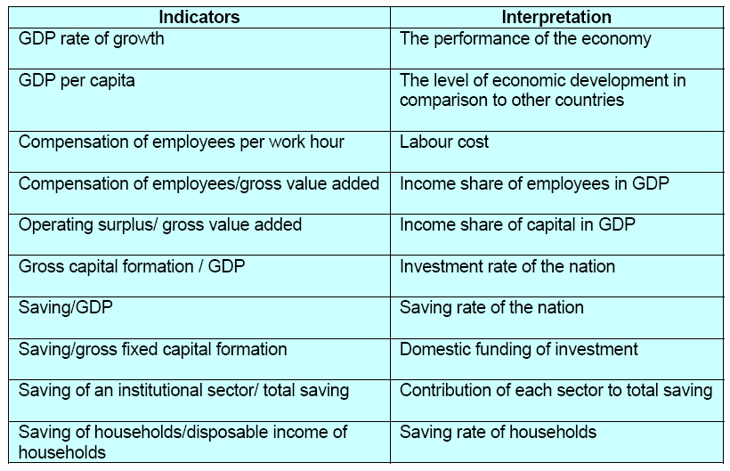
ECONOMIC PERFORMANCE INDICATORS

Slide 20
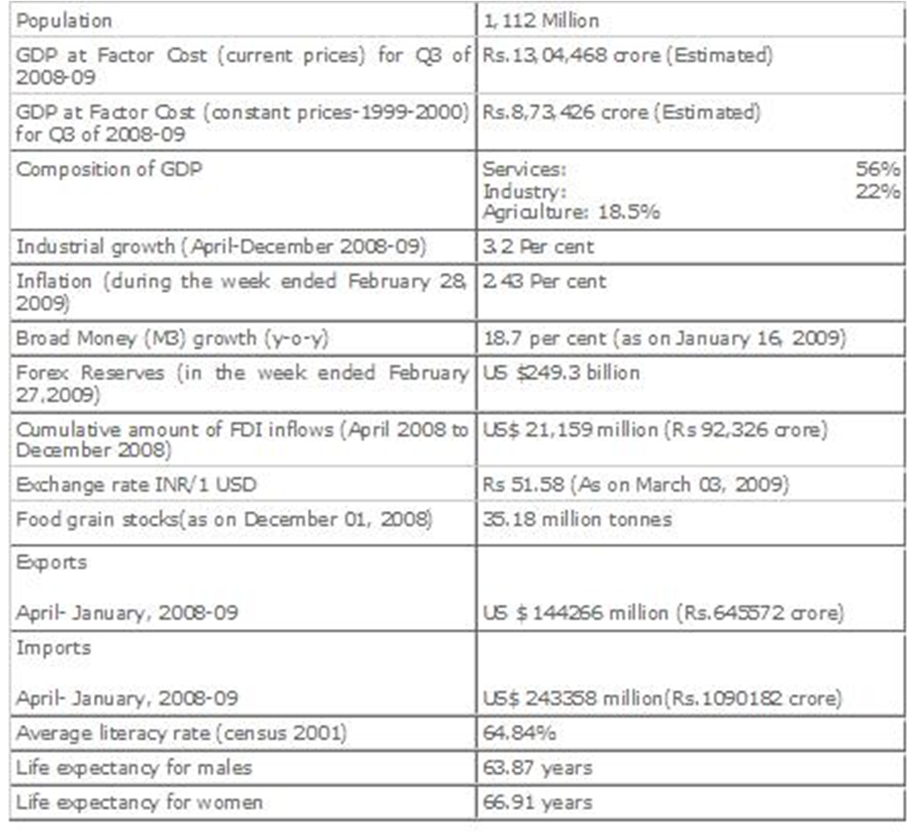
Macroeconomic indicators

Slide 21
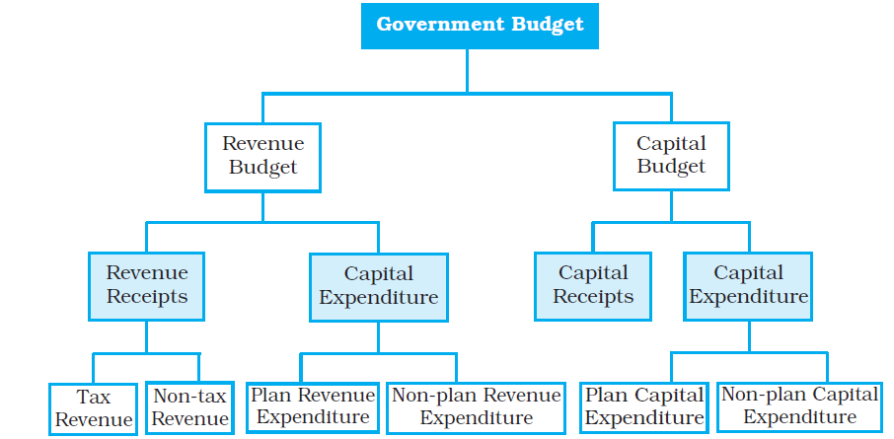
The Components of the Government Budget

Slide 22
Financial & Macro Economic Environment (MACRO INDICATORS: formulae)
12/7/2012
22

Slide 23
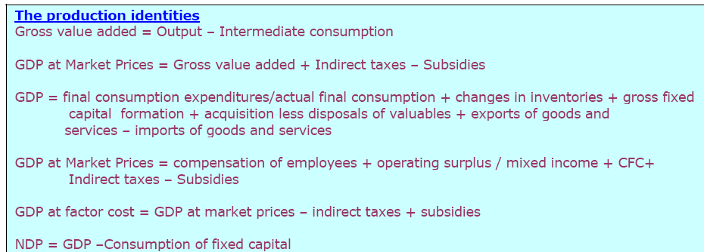
12/7/2012
23

Slide 24
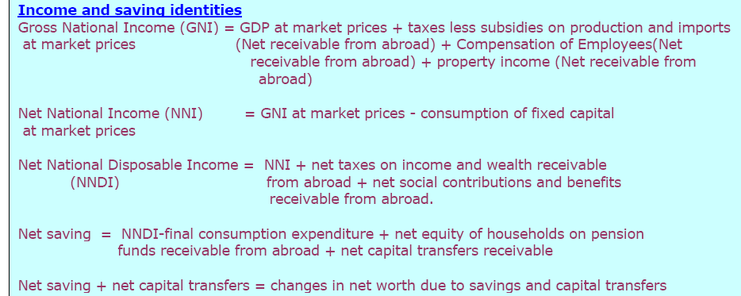
12/7/2012
24

Slide 25
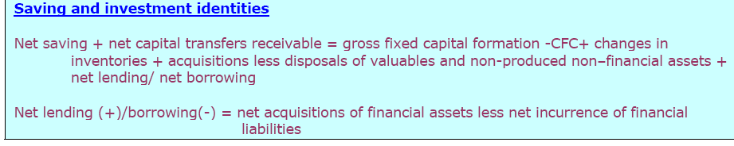
12/7/2012
25

Slide 26
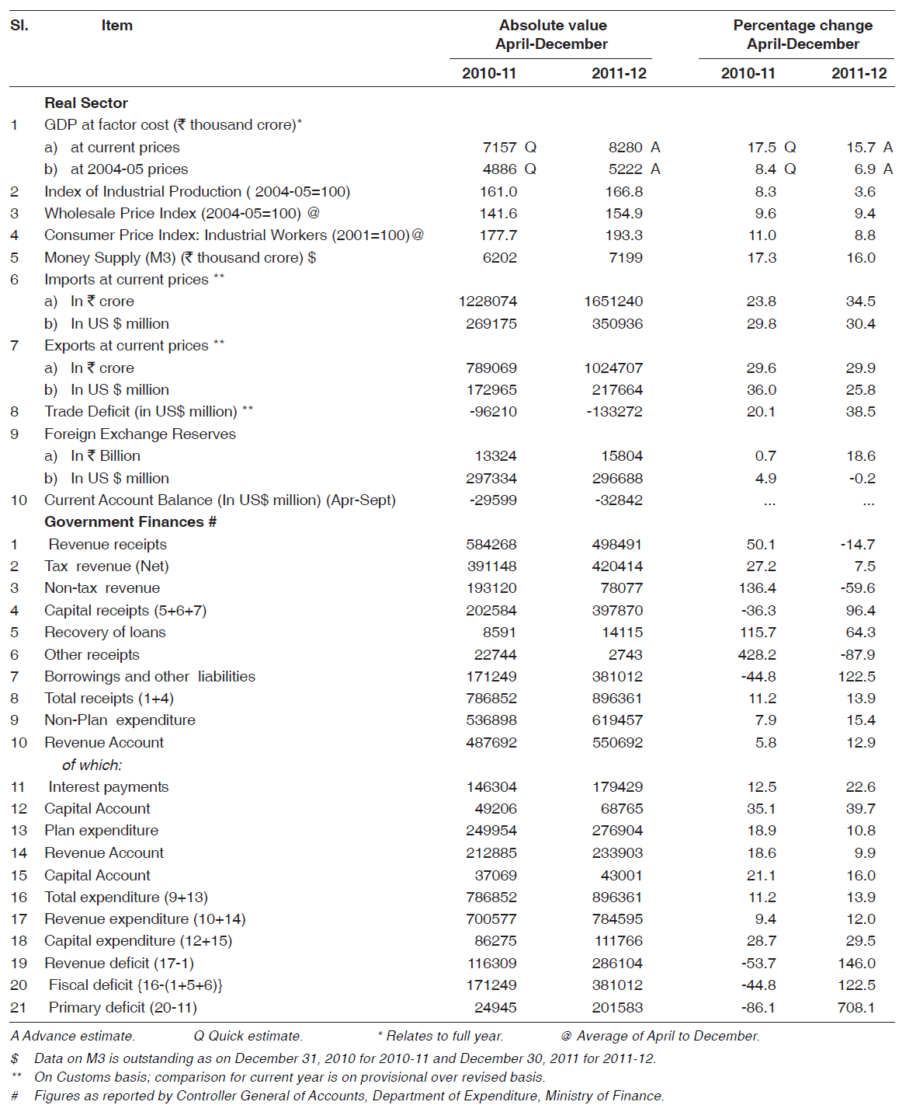
MACROECONOMIC FRAMEWORK STATEMENT

Slide 27
Thanking BITS PILANI, K.K.BIRLA GOA CAMPUS
Under the aegis of
Department of Economics
Dr. Debashish Pattanaik
Dr. Mridula Goel (HOD)
Dr. Aswini Kumar Mishra
Dr. Kubendran N.
Dr. Indranil De
Ms. Ambili K.
Mr. Swagat Kishore Mishra

